Slide 1
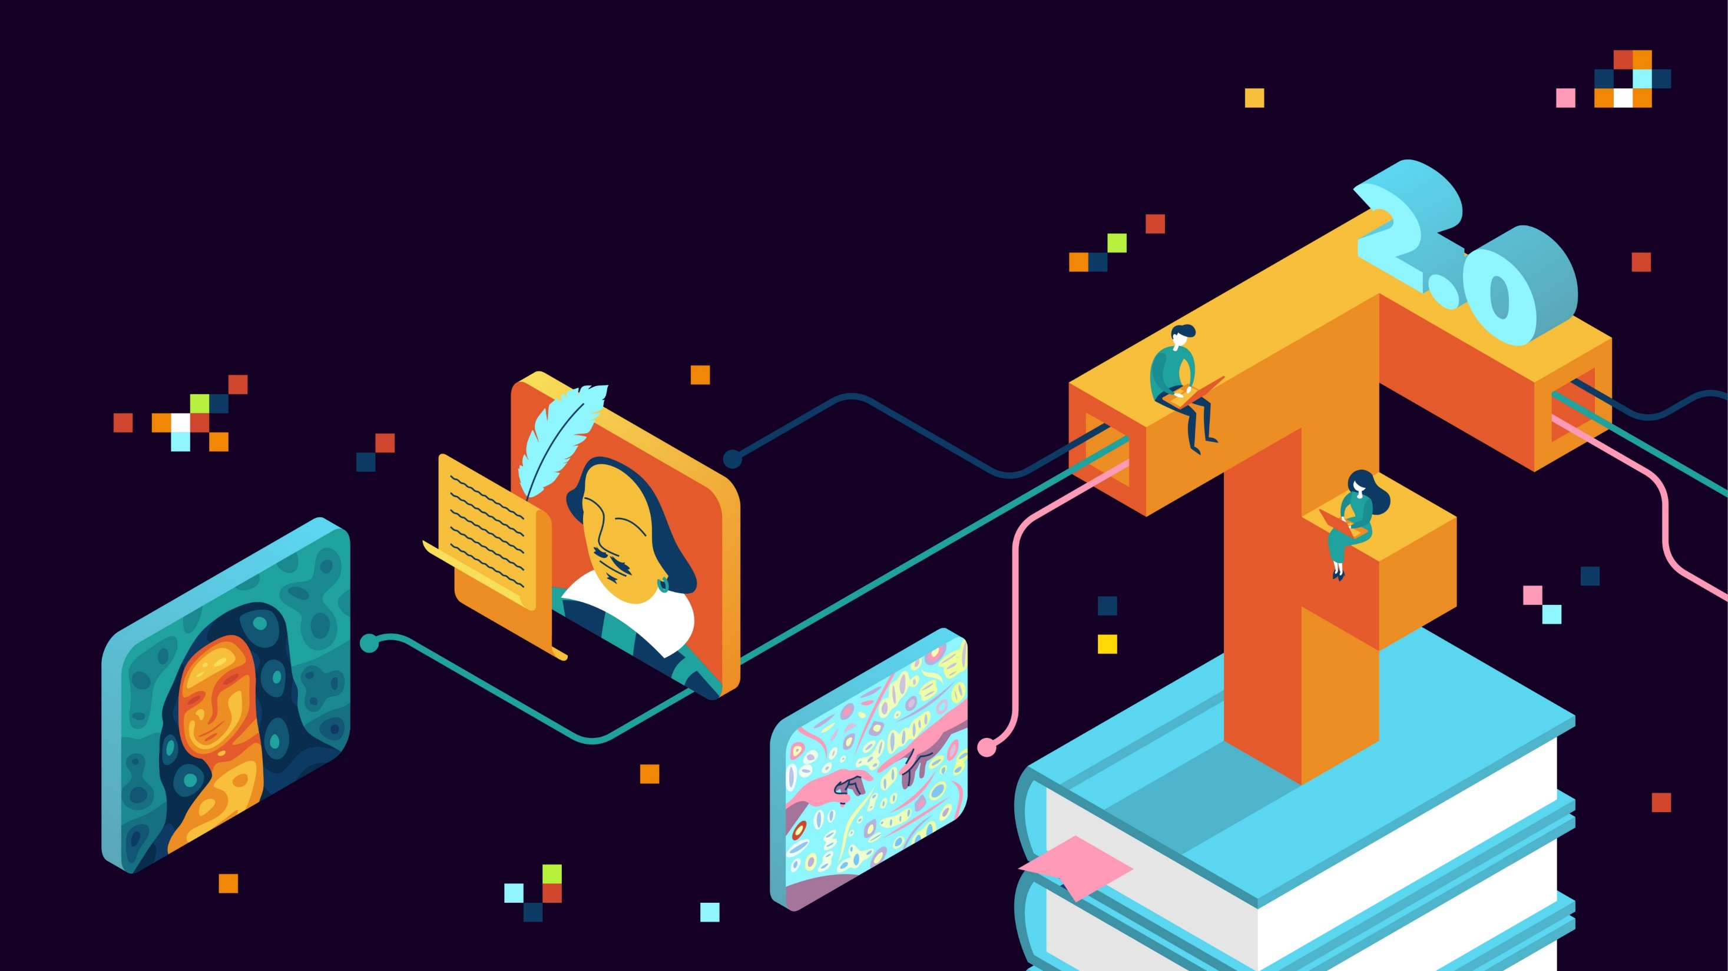
TENSORFLOW 2.0
PRACTICAL ADVANCED

Slide 2

GANS INTUITION

Slide 3
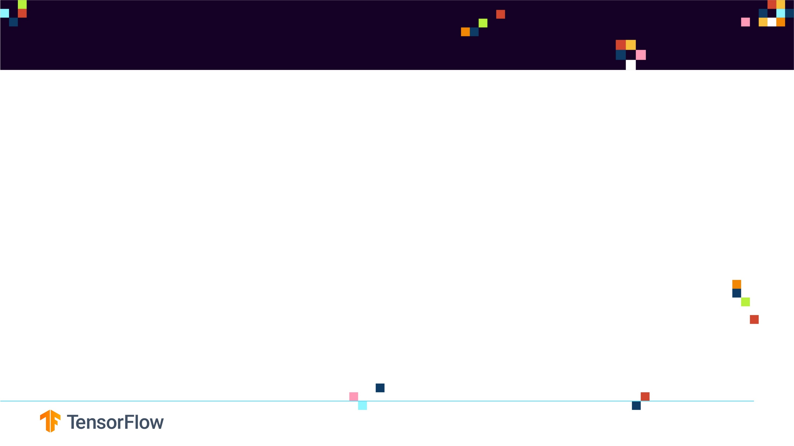
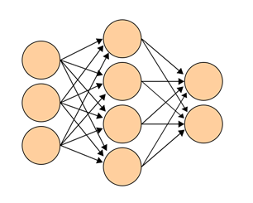
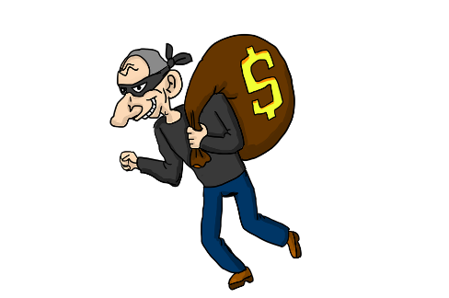

GENERATIVE ADVERSARIAL NETWORKS (GANS) INTUITION
“GANs are the most interesting idea in the last 10 years in Machine Learning”, Yann LeCun
GANs were developed by Ian GoodFellow in 2014.
GANs are formed of two competing networks known as the generator and discriminator.
GENERATOR
DISCRIMINATOR

Slide 4

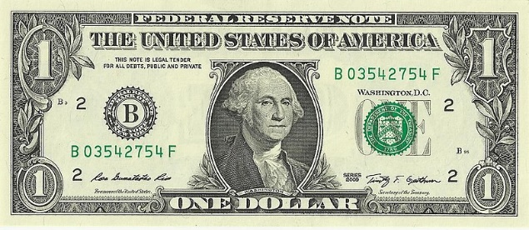

GENERATIVE ADVERSARIAL NETWORKS (GANS) INTUITION
DISCRIMINATOR
BANK
REAL MONEY
GENERATOR
FAKE MONEY
Photo Credit: https://commons.wikimedia.org/wiki/File:Police_man_ganson.svg
Photo Credit: https://pixabay.com/vectors/bank-money-finance-988164/
Photo Credit: https://pixabay.com/illustrations/thief-steal-thieve-criminal-crook-3306100/
Photo Credit: https://commons.wikimedia.org/wiki/File:US_one_dollar_bill,_obverse,_series_2009.jpg

Slide 5
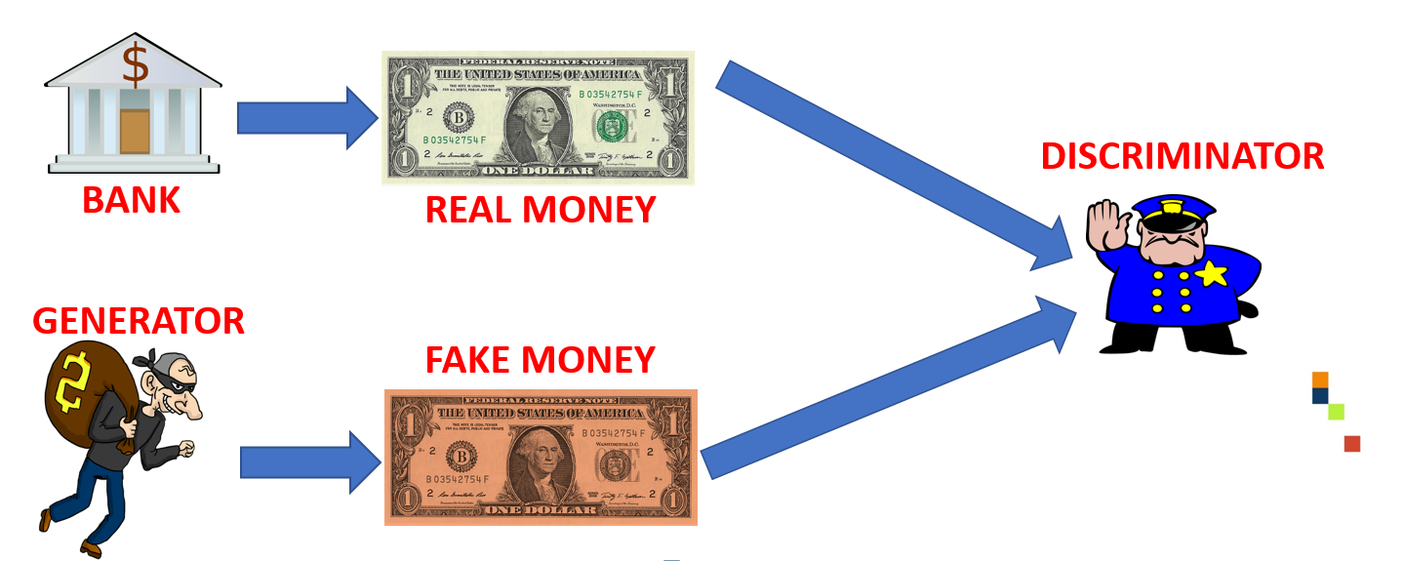
GENERATIVE ADVERSARIAL NETWORKS (GANS) INTUITION
GANs work by having a generator network (counterfeiter) who is being trained to create fake dollars that are indistinguishable from the real ones (generated by the bank).
The discriminator network (police) is being trained to determine if the money is real or fake.
The counterfeiter is trying to fool the police by pretending that he generated a real dollar bill.
But, the discriminator will detect the fake money and provide feedback to the generator on why does he think that the money is fake.
Overtime, the generator will become expert in generating new money that are indistinguishable from the real ones and the discriminator will fail to tell the difference.
Photo Credit: https://commons.wikimedia.org/wiki/File:Police_man_ganson.svg
Photo Credit: https://pixabay.com/vectors/bank-money-finance-988164/
Photo Credit: https://pixabay.com/illustrations/thief-steal-thieve-criminal-crook-3306100/
Photo Credit: https://commons.wikimedia.org/wiki/File:US_one_dollar_bill,_obverse,_series_2009.jpg

Slide 6
GENERATIVE ADVERSARIAL NETWORKS (GANS) –INTUITION
GANs are capable of generating new images that have never existed before.
GANs learn about the features of objects and create their own images.
GANs consists of a generator and discriminator.
Both the generator and discriminator start from scratch and learn together.
The Generator will generate images and the discriminator will compare these newly generated images (fake ones) to the true images (real ones) that are contained within the training dataset.
The generator works by trying to fool the discriminator by convincing it that the newly generated images are real ones.
Both networks learn together until the generator becomes a master at generating brand new images that are indistinguishable from the real ones.

Slide 7
GENERATOR Vs. DISCRIMINATOR

Slide 8
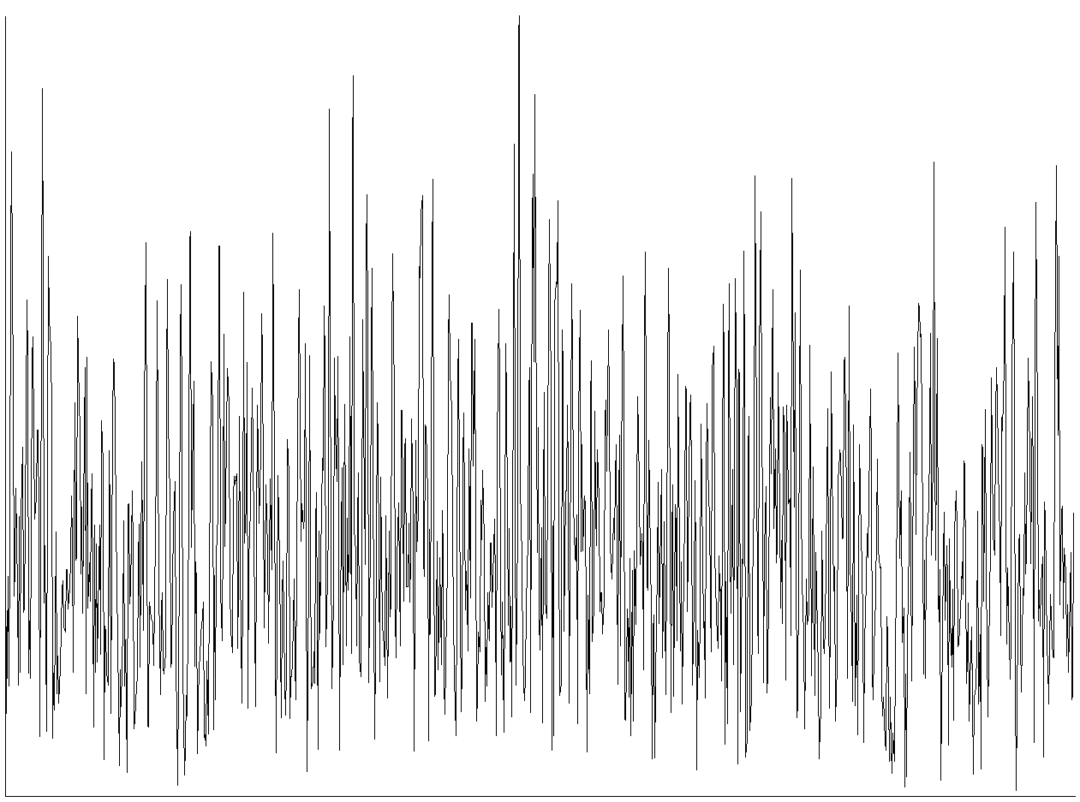

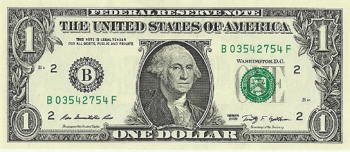
GENERATOR
The generator takes in a random noise signal and output images.
The generator is trying to generate fake images that are similar to the real images (ones that comes from the training data)
The objective of the generator is to fool the discriminator.
Labels are marked as follows:
Label = 1.0 indicates real images
Label = 0.0 indicates fake images
GENERATOR
Photo Credit: https://commons.wikimedia.org/wiki/File:Police_man_ganson.svg
Photo Credit: https://pixabay.com/vectors/bank-money-finance-988164/
Photo Credit: https://pixabay.com/illustrations/thief-steal-thieve-criminal-crook-3306100/
Photo Credit: https://commons.wikimedia.org/wiki/File:US_one_dollar_bill,_obverse,_series_2009.jpg

Slide 9
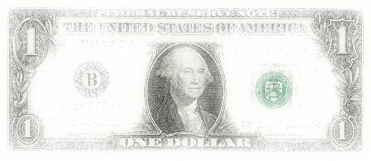

DISCRIMINATOR
The discriminator is a basic Neural Network that is trained to perform classification task
The discriminator is trained to do the following:
Output 0 (probability = 0%) when the input image is fake
Output 1 (probability = 100%) when the input image is real
DISCRIMINATOR
0
FAKE MONEY
1
REAL MONEY
Photo Credit: https://commons.wikimedia.org/wiki/File:Police_man_ganson.svg
Photo Credit: https://pixabay.com/vectors/bank-money-finance-988164/
Photo Credit: https://pixabay.com/illustrations/thief-steal-thieve-criminal-crook-3306100/
Photo Credit: https://commons.wikimedia.org/wiki/File:US_one_dollar_bill,_obverse,_series_2009.jpg

Slide 10
GENERATOR & DISCRIMINATOR TRAINING

Slide 11

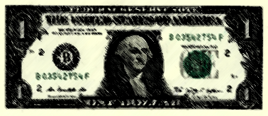
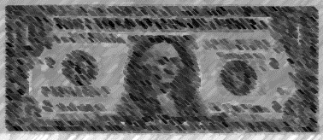


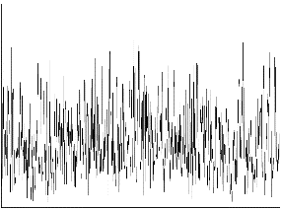
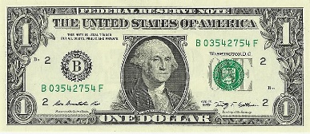
LET’S PUT THE GENERATOR AND DISCRIMINATOR TOGETHER (BIG PICTURE) – DISCRIMINATOR TRAINING
FAKE MONEY
GENERATOR
DISCRIMINATOR
0
1
REAL MONEY
UPDATE WEIGHTS
Photo Credit: https://commons.wikimedia.org/wiki/File:Police_man_ganson.svg
Photo Credit: https://pixabay.com/vectors/bank-money-finance-988164/
Photo Credit: https://pixabay.com/illustrations/thief-steal-thieve-criminal-crook-3306100/
Photo Credit: https://commons.wikimedia.org/wiki/File:US_one_dollar_bill,_obverse,_series_2009.jpg

Slide 12
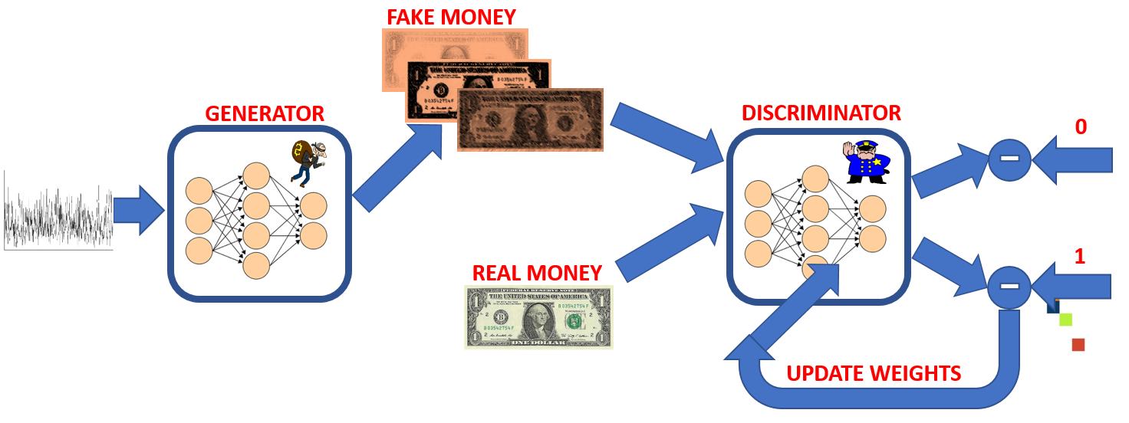
LET’S PUT THE GENERATOR AND DISCRIMINATOR TOGETHER (BIG PICTURE) – DISCRIMINATOR TRAINING
The discriminator training is performed as follows:
The generator will take in random noise and generate fake images
Both fake images and real ones are fed to the discriminator network (Feedforward path)
The discriminator will generate predictions based on the input images (both real and fake)
Discriminator predictions are then compared to the true labels to calculate the error
The problem is a basic binary classification ANN training, the discriminator is trained to predict 1 for real images and 0 for fake ones
The error is propagated through the network to update the discriminator weights (Backpropagation)
The generator weights are not updated at this stage
Photo Credit: https://commons.wikimedia.org/wiki/File:Police_man_ganson.svg
Photo Credit: https://pixabay.com/vectors/bank-money-finance-988164/
Photo Credit: https://pixabay.com/illustrations/thief-steal-thieve-criminal-crook-3306100/
Photo Credit: https://commons.wikimedia.org/wiki/File:US_one_dollar_bill,_obverse,_series_2009.jpg

Slide 13
LET’S PUT THE GENERATOR AND DISCRIMINATOR TOGETHER (BIG PICTURE) – GENERATOR TRAINING
FAKE MONEY
OBJECTIVE IS TO TRICK THE DISCRIMINATOR AND PRETEND AS IF IT IS A GENUINE REAL IMAGE
GENERATOR
DISCRIMINATOR
1
HOW FAR OFF AM I FROM GENERATING REAL IMAGES? (FEEDBACK)
UPDATE WEIGHTS
Photo Credit: https://commons.wikimedia.org/wiki/File:Police_man_ganson.svg
Photo Credit: https://pixabay.com/vectors/bank-money-finance-988164/
Photo Credit: https://pixabay.com/illustrations/thief-steal-thieve-criminal-crook-3306100/
Photo Credit: https://commons.wikimedia.org/wiki/File:US_one_dollar_bill,_obverse,_series_2009.jpg

Slide 14
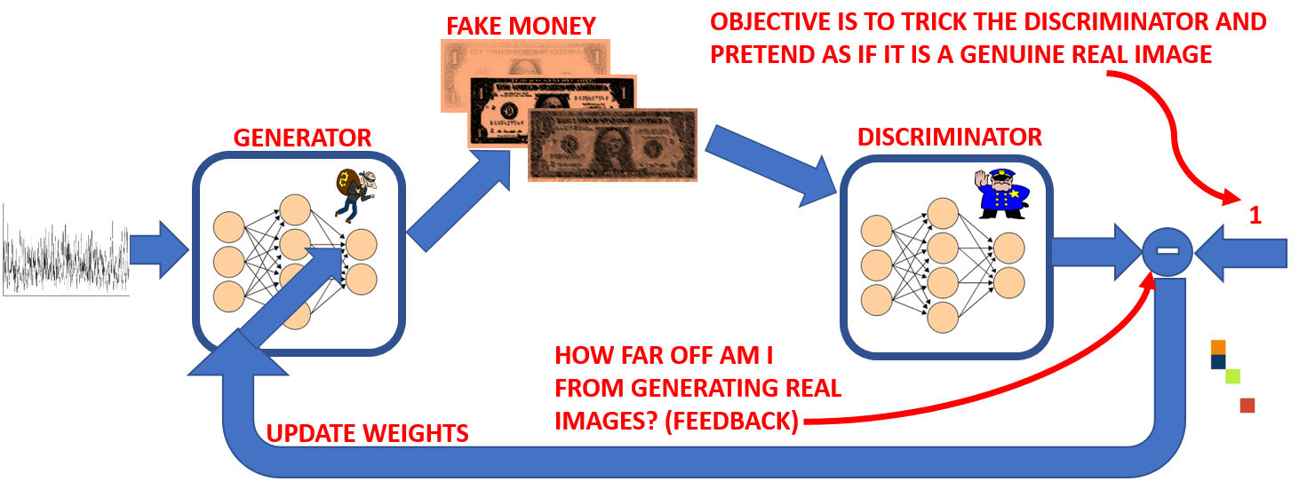
LET’S PUT THE GENERATOR AND DISCRIMINATOR TOGETHER (BIG PICTURE) – GENERATOR TRAINING
The generator training is performed as follows:
The generator will generate fake images (as usual!)
The fake images are fed to the discriminator and it will generate predictions (probably classified as fake~0)
The discriminator output will be compared to ones (1) because it is trying to fool the discriminator to think that this is a real image!
Another way of visualizing this, is that the discriminator predictions are compared to one so that the error will represent the feedback that answers the following question:
How far off am I from generating real images?
What should I do better to generate more realistic images?
The generator weights are updated while the discriminator weights are frozen.
Photo Credit: https://commons.wikimedia.org/wiki/File:Police_man_ganson.svg
Photo Credit: https://pixabay.com/vectors/bank-money-finance-988164/
Photo Credit: https://pixabay.com/illustrations/thief-steal-thieve-criminal-crook-3306100/
Photo Credit: https://commons.wikimedia.org/wiki/File:US_one_dollar_bill,_obverse,_series_2009.jpg

Slide 15
GENERATIVE ADVERSARIAL NETWORKS (GANS) –STOPPING CONDITION
Both the generator and discriminator are working against each other to get better at their assigned task
At the same time, they share information by assisting each other as well!
After multiple epochs, the generator becomes expert in generating real-like images that are indistinguishable from real ones.
The discriminator will reach a state when it cannot distinguish real from fake ones.

Slide 16
GAN LAB

Slide 17
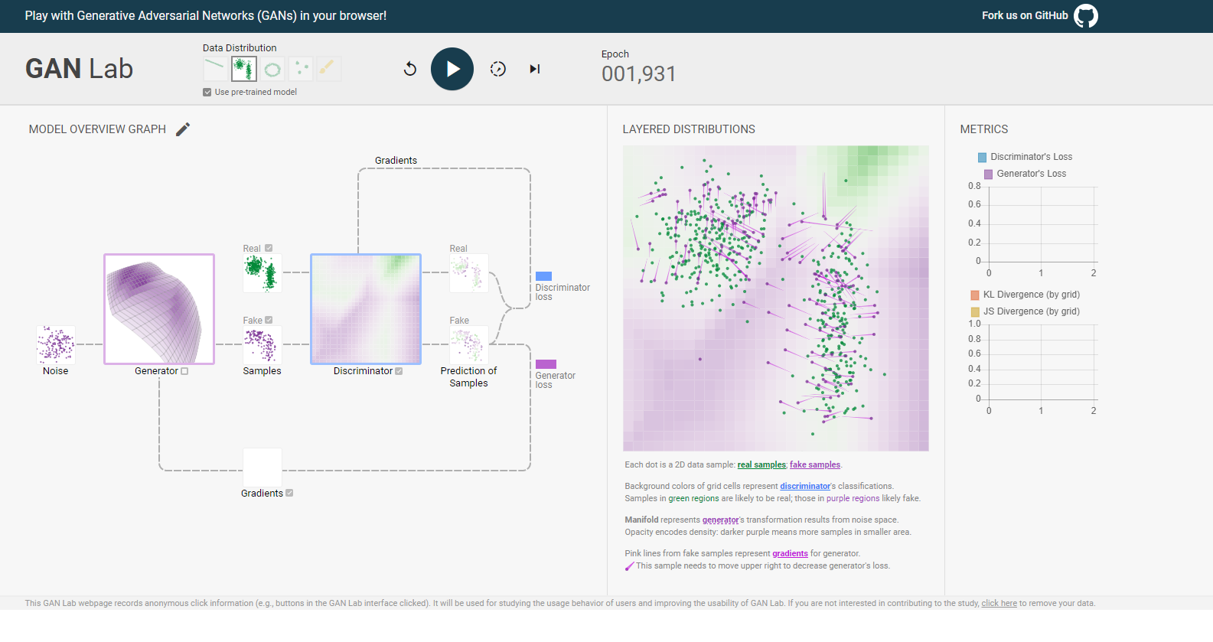
GAN LAB
GAN in Action: https://poloclub.github.io/ganlab/

Slide 18
GAN APPLICATIONS

Slide 19
GAN APPLICATIONS
https://medium.com/@jonathan_hui/gan-some-cool-applications-of-gans-4c9ecca35900

